Slide 1
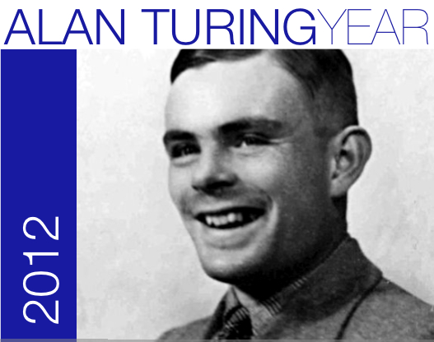
Who is Alan Turing?
http://www.bbc.co.uk/history/people/alan_turing
Notes:
http://www.bbc.co.uk/history/people/alan_turing

Slide 2
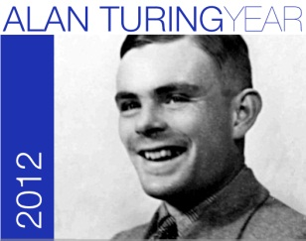
Learning Objectives
Know who Alan Turing was, and why he is important to ICT.
Be able to make a simple computer program using “Python”.

Slide 3
The Turing Test
The test involves a text chat using a keyboard and screen.
The Turing Test is a test of Artificial Intelligence.
Hello.
How are you?
...
Can you tell if you are chatting with a human or a computer!

Slide 4
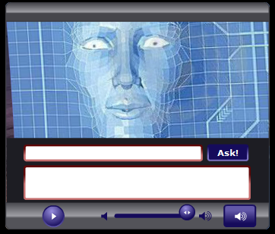
Chat Bots
Lots of chatbots have been created.
Try one for yourself: are you convinced that it could be human?
www.chaturing.com
Notes:
Set a fixed time limit, students will find it difficult to stop their conversations!

Slide 5
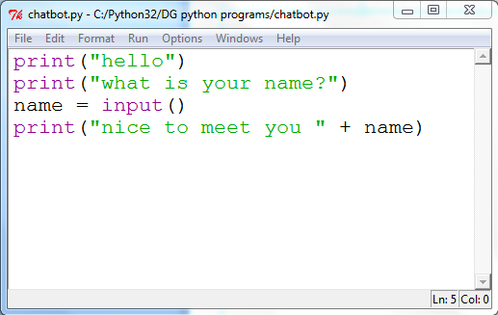
Creating your own chatbot…
Run Python (IDLE)
Create a New Window
Save As… chatbot.py
Run!

Slide 6
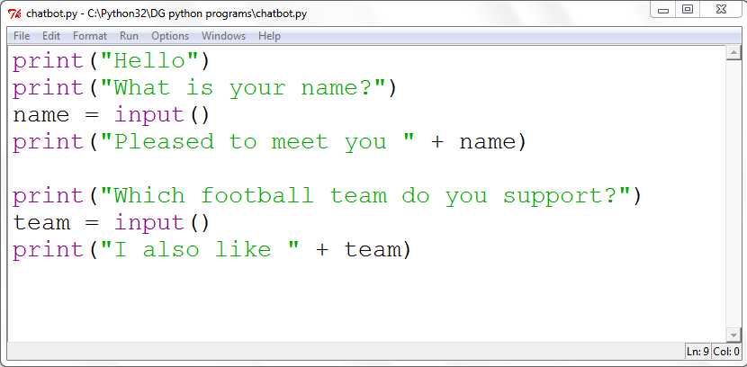
Asking more questions…

Slide 7
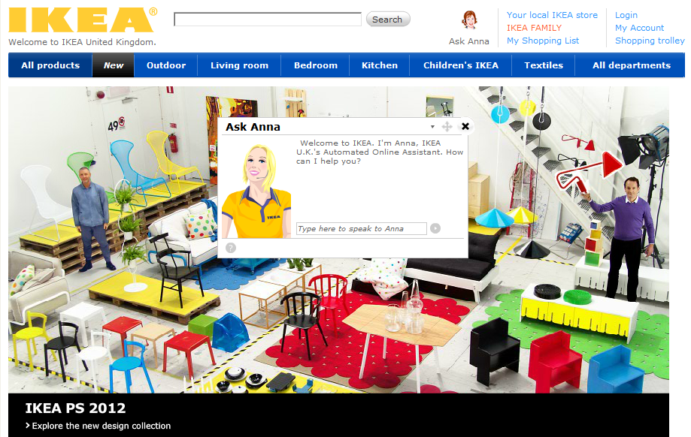
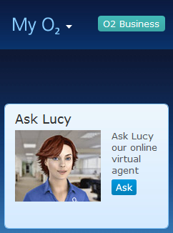
Useful Chat Bots

Slide 8
Chatbot Conversation?

